Slide 1


Data Governance @ SneakerPark
Prepared by: Jahid Razan
Submitted on: 6th Feb, 2023

Slide 2
Background
SneakerPark is an online shoe reseller that allows people to buy and sell used and new shoes. Buyers can bid for shoes or buy them outright, and sellers can set a price or sell to the highest bidder.
Each buyer and seller must have an active account in order to sell, bid, or purchase sneakers using SneakerPark’s website.
SneakerPark authenticates the shoes before shipping them to the buyer, so before listing an item, the seller must ship it to SneakerPark’s warehouse. Upon receipt, SneakerPark assigns an item number to each pair of sneakers and notifies the seller that they are now free to list their item. If the item is not listed within 45 days, SneakerPark returns it to the seller and sends an invoice to the seller for the shipping cost.
If the item is found to be inauthentic or in an unacceptable condition, it is also returned back to the seller in a similar fashion.
When the item sells, the buyer’s account is credited with the purchase price minus the SneakerPark service fee and shipping fees to deliver the item to the buyer.
Currently, SneakerPark only supports sales within the United States.

Slide 3
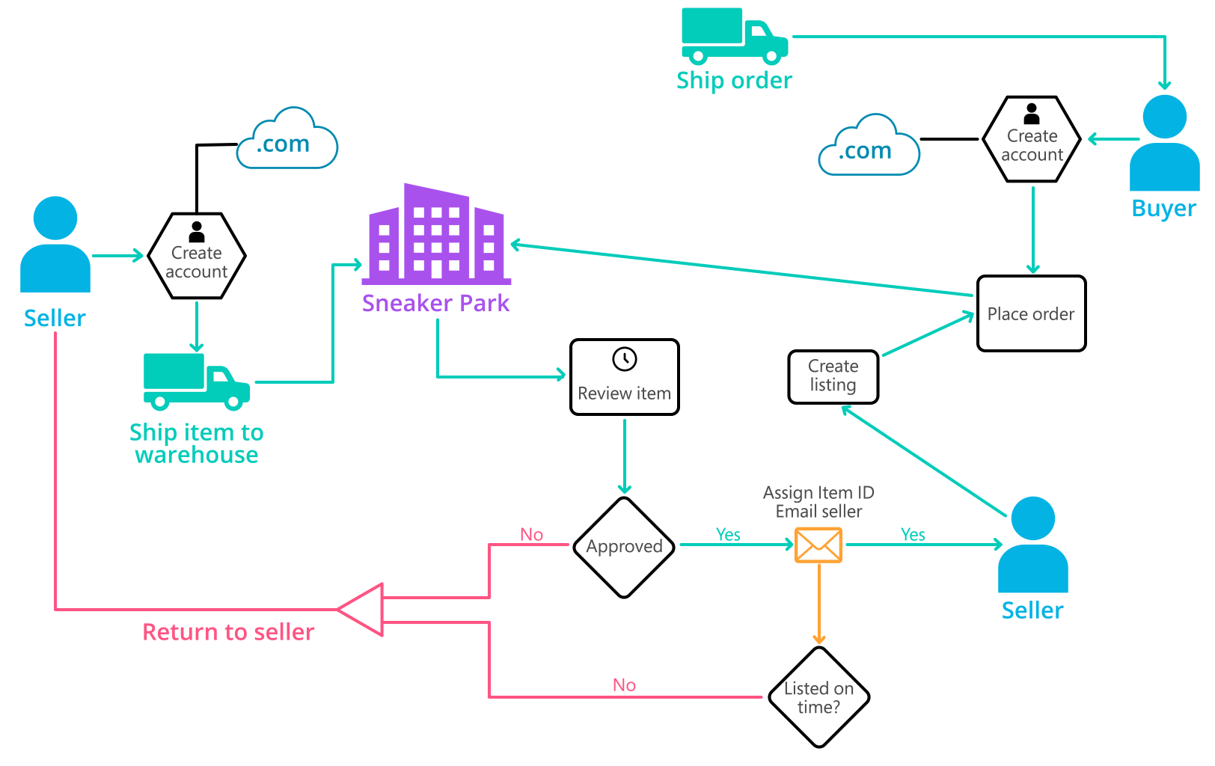
Background (cont’d)
Below you can see a diagram that will hopefully help you visualize some of SneakerPark's business processes. Keep in mind that it does not capture ALL processes and every nuance, but simply serves as another artifact to use in your project.

Slide 4
Step 1
Enterprise Data Catalog Part 1: Enterprise Data Model

Slide 5
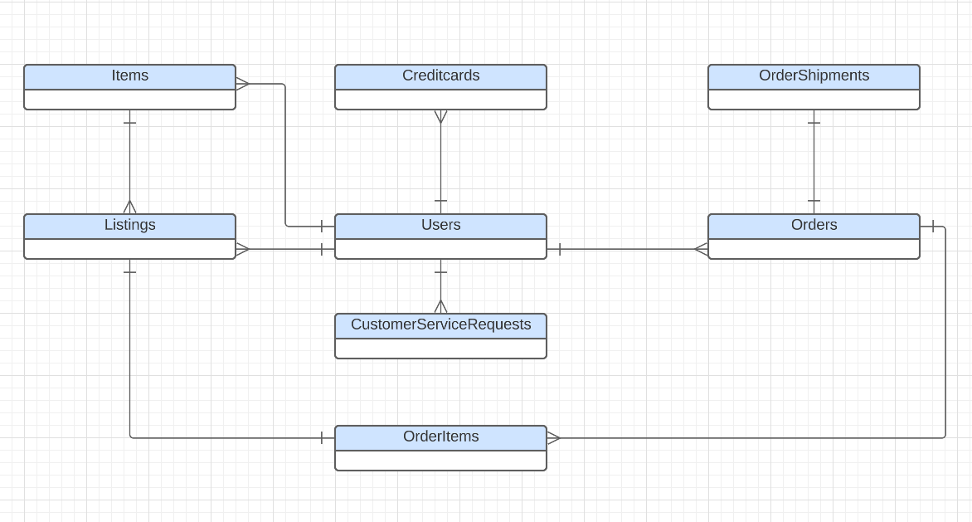
CONCEPTUAL DATA MODEL

Slide 6
Step 2
Enterprise Data Catalog Part 2: Metadata

Slide 7
DATA CATALOG
The Data Dictionary template has been filled out.
The Data Dictionary captures ALL tables and fields that can be found in the provided data.
Business Metadata template lists the domains, criticality of the data, retention policy, security classifications information.

Slide 8
Step 3
Data Quality
Part 1: Profiling and Cleansing

Slide 9
DATA QUALITY
Data Quality Issues tab lists existing and potential issues, description of the issues, example and suggested resolution

Slide 10
Step 4
Data Quality
Part 2: Monitoring

Slide 11
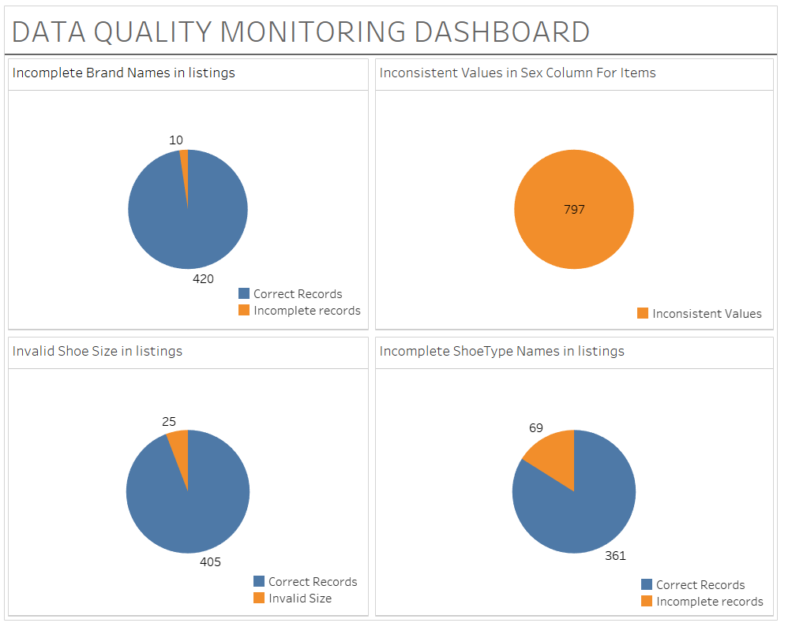
MOCKUP DASHBOARD

Slide 12
Step 5
Master Data Management
Part 1: MDM Architecture

Slide 13
SELECTION OF MDM ARCHITECTURE
I've chosen to go with the Consolidated style of architecture for the following reason-
SneakerPark has a number of systems such as User Service, Inventory Management System, Listing Service, Order Processing Service and Customer Service. Growing amount of data discrepancies among the systems causing mischarges, lost revenu and frustated customers. The scenario description states that the company wants to improve its consistency of the data across the systems for business optimization which can be done by using sound analytics. For that reason, I believe consolidating data from all these systems into a central MDM Hub that can feed merged, cleansed, and verified customer golden records to data warehouses and reports is the best solution here.
The business rules and governance policies in Consolidated architecture are applied and managed consistently in one place resulting in strong data governance.
Consolidated MDM requires the implementation of the MDM hub, and hence the cost and complexity are medium.

Slide 14
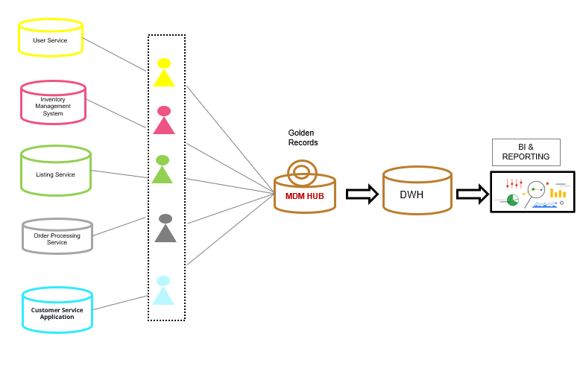
MDM DIAGRAM

Slide 15
Step 6
Master Data Management
Part 2: Master Record

Slide 16
RULES FOR CREATING MASTER RECORD
Two matching rules for Customers :
Both the creditcards and CustomerServiceRequestsdata are related to the users table by the userId column and therefore the 2 rules are -
1. Match creditcards on UserID
2. Match CustomerServiceRequestsdata on UserID
Two matching rules for Items:
1. Match ItemID from items table with ProductID from listings table.
2. Match Type from items table with Shoetype from listing table, Match size from both the tables

Slide 17
Step 7
Data Governance:
Roles and Responsibilities

Slide 18
DATA GOVERNANCE
Data Quality Issues: Currently SneakerPark has existing completeness, validity and consistency issues. Also, for sneakerPark there is no threshold level defined for the existing data columns to indicate the data quality and the user has no way to know whether the data is good to use.
Metadata Management: SneakerPark currently has no metadata management in place. There is no data catalogue and the analytics department does not know what data are available and what type of analytics can be performed. However, the current data governance initiative of creating is a step forward.
MDM: SneakerPark is currently setting up its first MDM initiative. However, the company still needs to set some rules related to budget and long term goals. That is required to ensure that the right architecture is choses that is aligned with the objective. Also, the company currently does not have any data steward who will play a crucial rule to materialize the business objectives for the initiatives.

Slide 19
ROLES AND RESPONSIBILITIES
Currently SneakerPark has a senior business analyst – the person is a company veteran and a subject-matter-expert who can help in defining the match rules. Also the company has an IT expert who can assist with queries related to database and systems.
However, currently there is no data steward to perform activities like checking the results that comes out of the match rules. Also the data steward can help fixing the columns with completeness and validity issues, that are currently available in the sneakerperk data, accept or reject results coming out of matching rules and manually overwrite the results when needed. SneakerPark needs to employ data steward with domain expertise such as experts on customer service application, expert on Inventory management and expert on user service.
The IT personal can assist implementing the rules in the MDM database. However, with growing amount of data and more potential issues and the high availability requirements of the systems it seems that the company does not have enough IT personal. This makes the unavailability of the person as the single point of failure.

